Slide 1
AGENDA
Scope of This Review
Requirements (Functional & NFR)
Detailed System Architecture
Use Case & ER Diagrams
Module Description & Tech Stack
UI Design, Frontend & Backend Build
Database & API Integration
Progress (94%), Screenshots & Challenges
Agenda
Review 1 | NewsGuard AI (MERN Stack)

Slide 2
01
REQUIREMENTS
Functional & Non-Functional Requirements
Functional Requirements
Non-Functional Requirements
Register and sign in with email OTP or Google
Analyze news by article URL or pasted text
Weighted credibility score with a verdict
Claim extraction and evidence checks
Report page, PDF export, save and history
Admin: users, sources, flagged articles
Real-time, email and browser alerts
Browser-extension hand-off (scaffold)
Security: JWT, hashed passwords and OTPs
SSRF guard and input sanitization
Rate limits on API and analysis
Cache: Redis with in-memory fallback
Responsive UI with mobile navigation
AI outage falls back to heuristics
Modular MERN code, 9 unit tests
Requirements
Review 1 | NewsGuard AI (MERN Stack)

Slide 3
02
ARCHITECTURE
System Architecture (Detailed)
CLIENT TIER
APPLICATION TIER
DATA TIER
React 18 + Vite
Router, Context, Axios
Socket.IO client
Bootstrap + custom CSS
↔
Node.js + Express.js
JWT, Helmet, rate limits
Scoring & evidence engine
Socket.IO, PDF, email
↔
MongoDB + Mongoose
9 collections, 16 indexes
Redis cache (optional)
with in-memory fallback
HTTPS requests flow from React through Express REST endpoints to MongoDB; Socket.IO pushes live analysis progress back to the browser.
External services are optional: Gemini API and Serper search feed the evidence step, with an automatic heuristic fallback. The app itself calculates the final score.
Architecture
Review 1 | NewsGuard AI (MERN Stack)

Slide 4
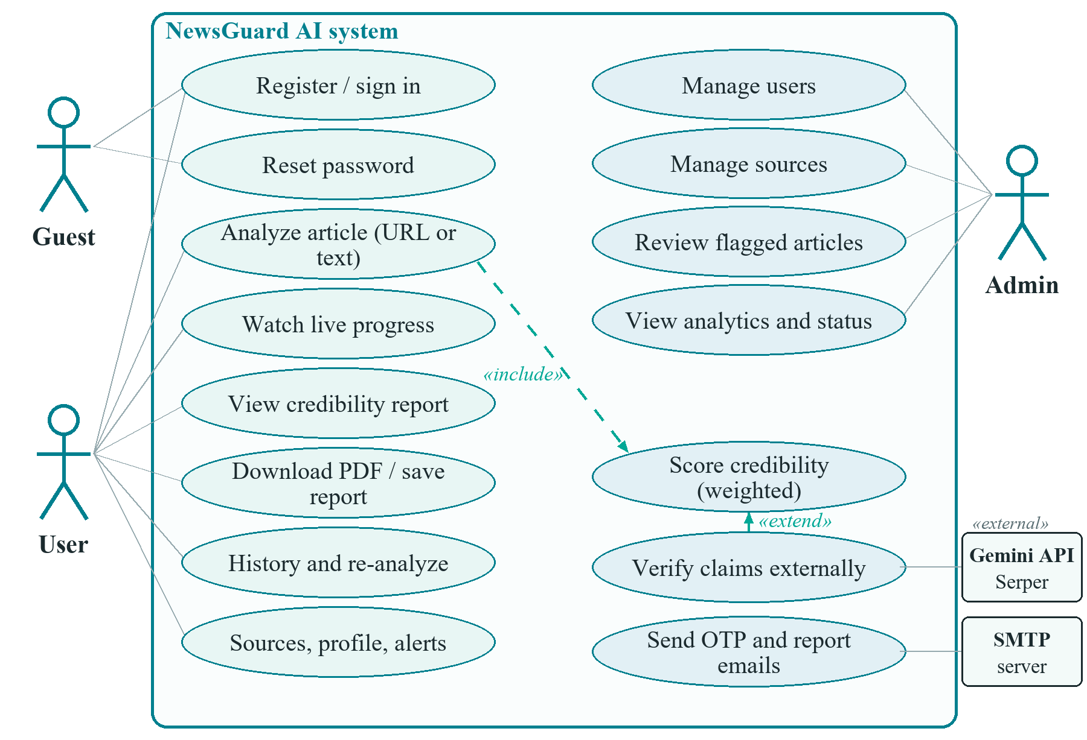
03
USE CASE
Use Case Diagram
Actors & Use Cases
Guest: register, sign in, reset password
User: analyze a URL or pasted text
User: view report, PDF, save, history
Admin: users, sources, flagged items
Gemini, Serper and SMTP are external
Use Case
Review 1 | NewsGuard AI (MERN Stack)

Slide 5
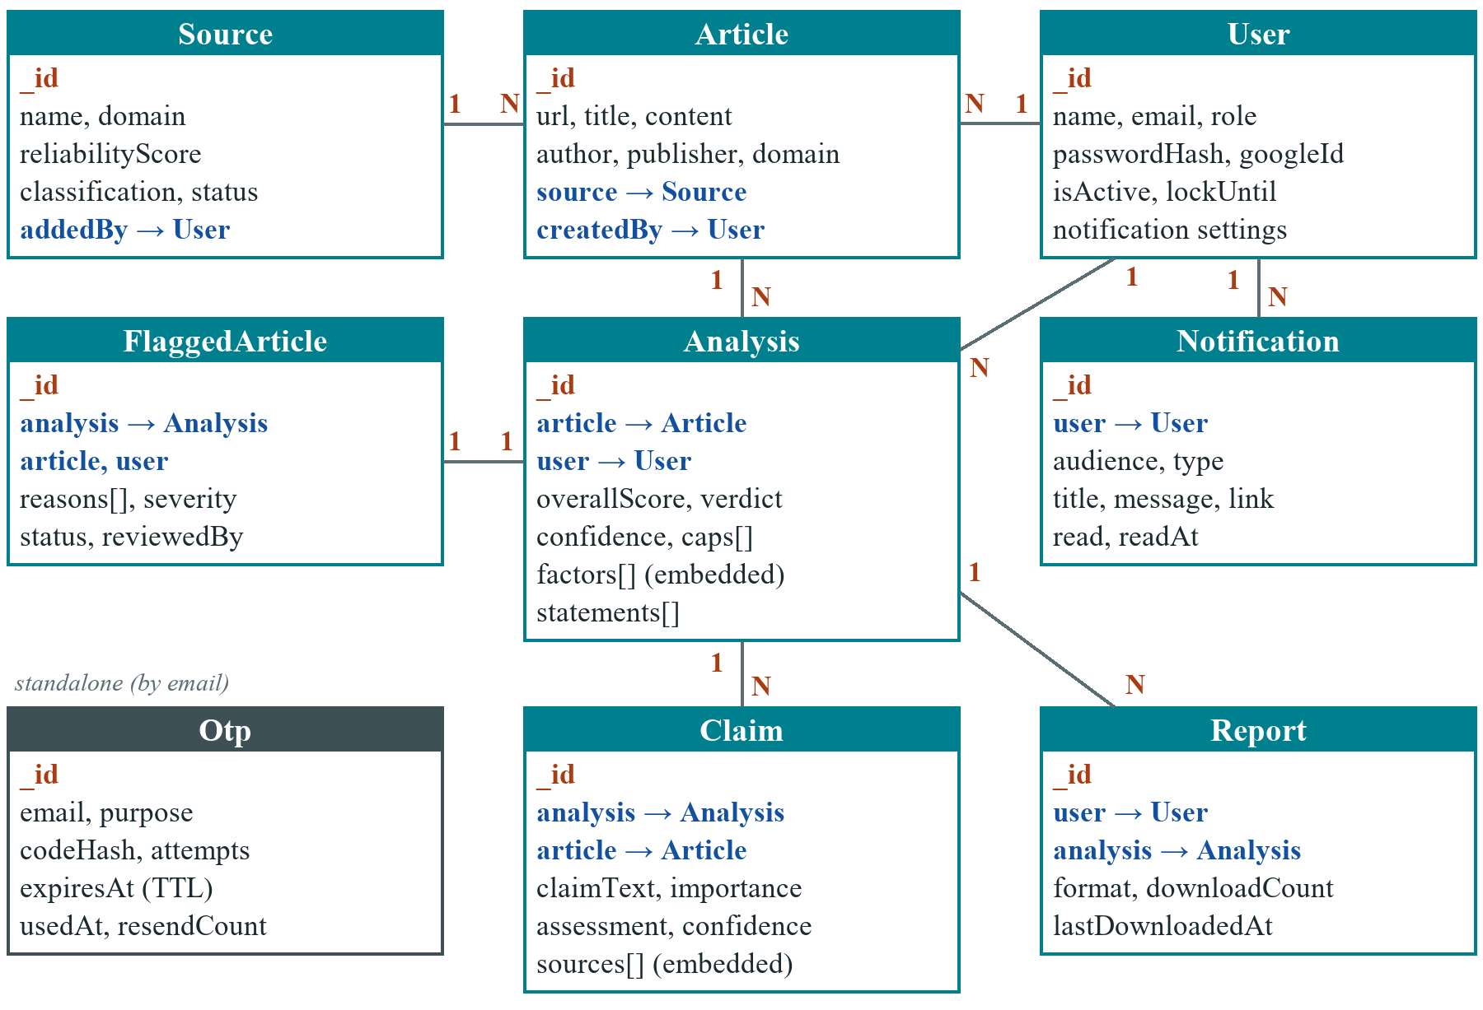
04
ER DIAGRAM
ER Diagram / Database Design
Design Notes
9 MongoDB collections, 16 indexes
1:N: User to Analysis, Analysis to Claim
1:1: Analysis to FlaggedArticle
Embedded: score factors, statements
Otp records expire by TTL index
ER Diagram
Review 1 | NewsGuard AI (MERN Stack)

Slide 6
05
MODULES
Module Description
Module | Description | Key Functions
Authentication | Email + OTP or Google sign-in, JWT sessions, role guard | Register, Login, Verify OTP, Reset
Analysis Engine | URL or pasted text, claim checks, weighted score with caps | Extract, Verify, Score
Reports & History | Credibility report, PDF export, saved reports | View, Download, Save, Re-analyze
Source Registry | Publisher reliability records used in scoring | Browse, Classify, Auto-register
Admin Module | Manage users, sources and flagged articles | Activate, Review, Analytics
Notification Module | Real-time, email and browser alerts | Socket toasts, Email + PDF
Modules
Review 1 | NewsGuard AI (MERN Stack)

Slide 7
06
TECH STACK
Technology Stack
MongoDB
Express.js
React.js
Node.js
Mongoose 8 ODM
Express 4 REST API
React 18 + Vite 5
Node.js runtime
Supporting Tools
Backend: Mongoose, JWT, bcryptjs, Helmet, express-rate-limit, Multer
Real-time and cache: Socket.IO, ioredis (Redis) with memory fallback
AI and evidence: Gemini API (optional), Serper search, Cheerio extraction
Output: PDFKit reports, Nodemailer email, Chart.js, Framer Motion
Tooling: Bootstrap 5, Axios, node:test, Git, npm
Tech Stack
Review 1 | NewsGuard AI (MERN Stack)

Slide 8
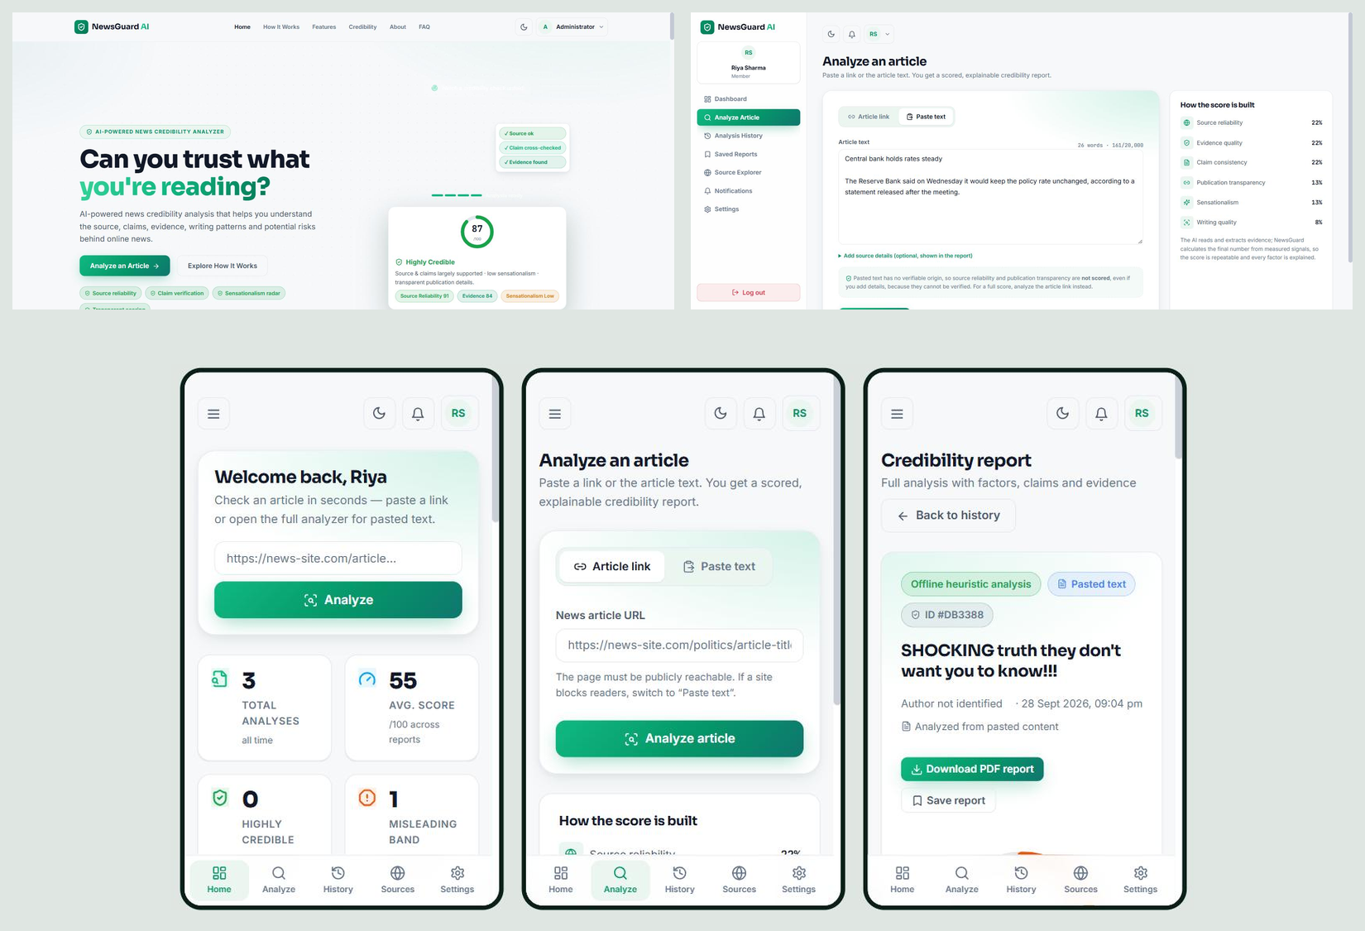
07
UI DESIGN
UI Design / Wireframes
Design Highlights
Final screens, built in React
Light and dark themes
Bottom navigation below 992 px
CSS design tokens, no Figma files
Landing, analyze, report, mobile
UI Design
Review 1 | NewsGuard AI (MERN Stack)

Slide 9
08
FRONTEND
Frontend Development
React 18 + Vite 5 with functional components and hooks (64 JSX files)
React Router: 25 routes across public, auth, user and admin areas
Context API for auth and theme; Axios client with JWT interceptor
Analyze page: link or paste mode, live progress over Socket.IO
Report page: score ring, factor bars, caps, confidence, claims, PDF
Bootstrap 5 with custom design tokens, light and dark mode
Chart.js dashboards; admin and report pages lazy-loaded
Done: Landing, Login, Register, OTP, Reset, Dashboard, Analyze, Report, History, Saved, Sources, Notifications, Settings, 8 admin pages.
Frontend
Review 1 | NewsGuard AI (MERN Stack)

Slide 10
09
BACKEND
Backend Development
Node.js + Express 4: routes, controllers, services, Mongoose models
50 REST endpoints: auth, user, analysis, sources, admin
JWT middleware, role guard, OTP sign-in, login lockout
Helmet, CORS allow-list, rate limits, SSRF guard, input sanitization
Scoring engine: 6 weighted factors, score caps, confidence
Gemini (optional) bounded by a heuristic baseline; Serper search
Redis or in-memory cache, Socket.IO, PDFKit, 9 unit tests
Central errorHandler, utils/validate checks, dotenv config (.env is git-ignored).
Backend
Review 1 | NewsGuard AI (MERN Stack)

Slide 11
10
DATABASE
Database Integration
MongoDB with Mongoose 8 (local or Atlas URI through MONGO_URI)
9 collections: User, Article, Analysis, Claim, Source, Report, FlaggedArticle, Notification, Otp
References: Analysis to User and Article, Claim to Analysis
Embedded: score factors, suspicious statements, claim sources
16 declared indexes, including a text index and a TTL index
Admin account seeded from .env; no demo data in the repository
Optional Redis cache with in-memory fallback
Collections: users, articles, analyses, claims, sources, reports, flaggedarticles, notifications, otps.
Database
Review 1 | NewsGuard AI (MERN Stack)

Slide 12
11
API
API Development
Method | Endpoint | Description
POST | /api/auth/register | Create account, send OTP
POST | /api/auth/login | Check password, email OTP
POST | /api/auth/verify-otp | Verify OTP, issue JWT
POST | /api/analysis/url | Analyze an article link
POST | /api/analysis/content | Analyze pasted text
GET | /api/analysis/history | Search, filter, sort history
GET | /api/analysis/:id | Full credibility report
GET | /api/analysis/:id/report | Download PDF report
GET | /api/admin/analytics | Platform analytics (admin)
API
Review 1 | NewsGuard AI (MERN Stack)

Slide 13
12
STATUS
Module-wise Implementation Status
User Authentication (10/10)
100%
Frontend UI (Core Screens) (8/9)
89%
Backend APIs (9/10)
90%
Database Integration (9/10)
90%
Admin Module (8/8)
100%
Notifications (7/7)
100%
Status
Review 1 | NewsGuard AI (MERN Stack)

Slide 14
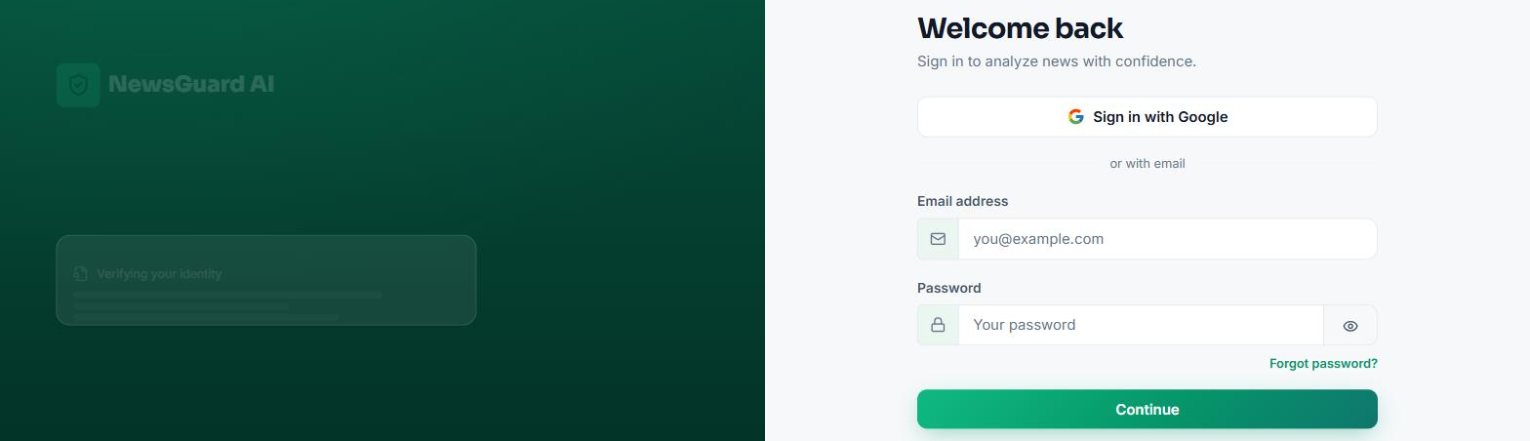
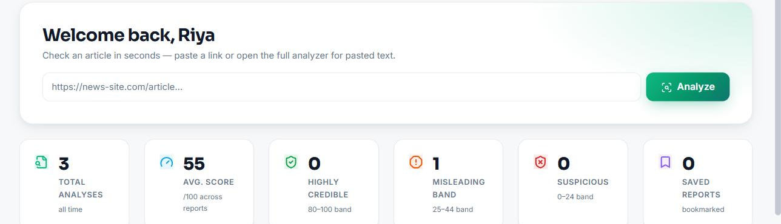
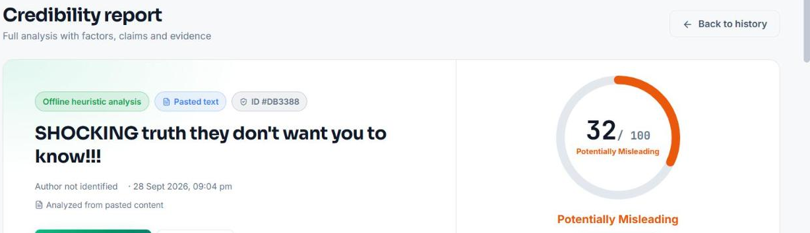
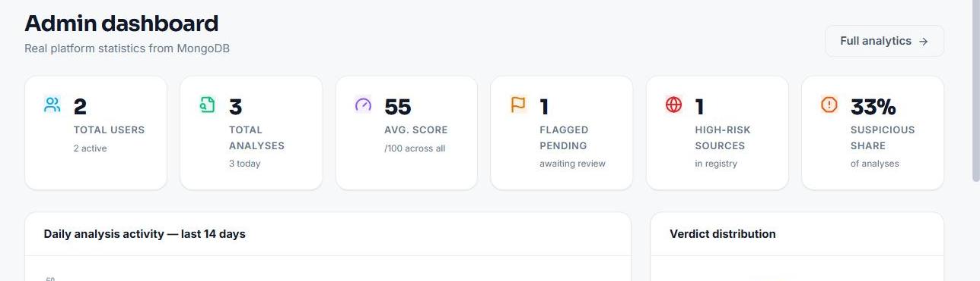
13
SCREENSHOTS
Screenshots
Login page
User dashboard
Credibility report
Admin dashboard
Screenshots
Review 1 | NewsGuard AI (MERN Stack)

Slide 15
14
CHALLENGES
Challenges Faced & Solutions
Challenge | Solution Adopted
Pasted text scored as an unknown source | Source and transparency excluded; weights renormalised
AI scores could swing the final result | AI bounded around a measured baseline; app applies weights
Server-side fetch could reach internal hosts | Public-IP check on DNS and on every redirect hop
AI or search outages | Automatic heuristic fallback; reports still scored
Repeated fetches and AI calls were slow | Redis or memory cache: 484 ms to 45 ms on repeat
Not-scored flag was lost on save | Added field to schema; verified in report UI
Challenges
Review 1 | NewsGuard AI (MERN Stack)

Slide 16
15
NEXT STEPS
Remaining Work & Plan
Validate the Gemini and Serper evidence path with live API keys
Run a live Redis server and confirm cache behaviour under load
Add API integration tests beyond the 9 unit tests
Verify SMTP delivery and Google sign-in with real credentials
Accessibility and cross-browser audit; package the extension
Deploy (frontend host + MongoDB Atlas); final documentation and demo
Next Steps
Review 1 | NewsGuard AI (MERN Stack)

Slide 17
16
REFERENCES
References
# | Reference
1 | MongoDB, Express.js, React, Node.js: official documentation
2 | Mongoose, Socket.IO, Vite, Bootstrap: official documentation
3 | Google Gemini API and Serper search API documentation
4 | K. Shu et al., Fake News Detection on Social Media: A Data Mining Perspective, ACM SIGKDD, 2017
5 | W. Y. Wang, "Liar, Liar Pants on Fire": A New Benchmark Dataset for Fake News Detection, ACL, 2017
6 | K. Shu and H. Liu, Detecting Fake News on Social Media, 2019
References
Review 1 | NewsGuard AI (MERN Stack)

